Slide 1

Python Libraries

Slide 2
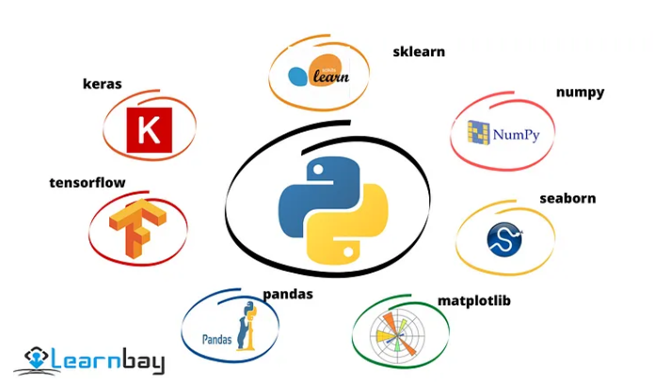

Slide 3
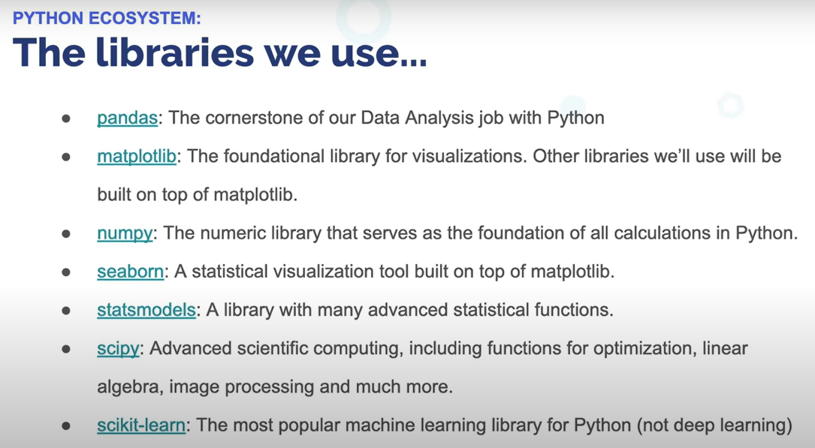

Slide 4

Data processing:
numpy: It is an abbreviation of numerical python which is a perfect tool for scientific computing and to perform from basic to advanced array operations. numpy offers many features to perform operations on n-array and matrics(n — indicates dimensions) like scaler and vectorization. It also helps to store the values of the same data type to make mathematical operations. It provides features to increase the performance in less execution time.
The Ultimate NumPy Tutorial for Data Science Beginners
scipy:
scipy is useful for linear algebra, integration, statistics, and optimization. Its most important functionality is that it is built upon numpy so it has similar features as numpy contains. It works for all types of scientific programmings such as science, mathematics, and engineering. All the array operations can be performed by using this library of n-array.

Slide 5

Data manipulation and analysis:
PANDAS:
From Data Exploration to visualization to analysis. It provides to access the n dimensions dataset with .csv, .html, .doc, .text, .json files.
It offers to work with labelled and relational datasets.
It contains the two most important features that are
It works with data structures like series and lists.
It allows us to work with a big dataset like data frames with n-dimensions and in table format.
It offers to convert the data structures into the data frame and to provide some data analysis tasks to find out the missing values, plot the data with histogram, drop the null values columns, and more. It has all the data manipulation, optimization, visualization, and data wrangling features.
Pandas for Data Analysis
https://www.hackerearth.com/practice/machine-learning/data-manipulation-visualisation-r-python/tutorial-data-manipulation-numpy-pandas-python/tutorial/

Slide 6
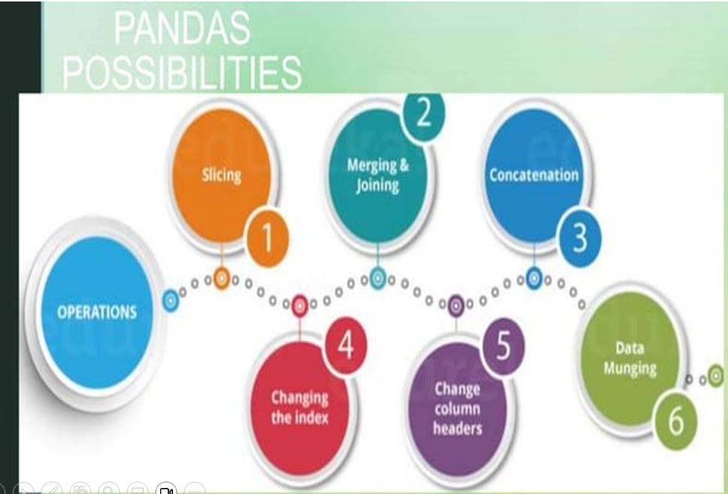

Slide 7

Data visualization:
matplotlib:
matplotlib is a standard library for data science that helps in generating data representation in 2D and 3D planes. The data is represented in graphs, histograms, boxplots, scatter plots, bar charts, pie charts, and many types of graphs. It also provides an object-oriented API to embed the plot into applications. It has a feature that it provides the scientific tools, unlike Matlab and Mathematica. It is used for a structured dataset for manipulation and data management and also used for data preparation before feeding the data to the ML model.
seaborn:
As scipy built upon numpy similarly seaborn built upon the matplotlib, so it has all the features as matplotlib offers with additional qualities. It is also used for data visualization for statistical models. Heatmaps and other various kinds of visualization are used for data visualizations. It is used for statistical data visualization and gives informative statistical graphics.
https://colab.research.google.com/drive/10esU2RhHFiWA9waq3qQc7TcCpnBM4weA?usp=sharing

Slide 8
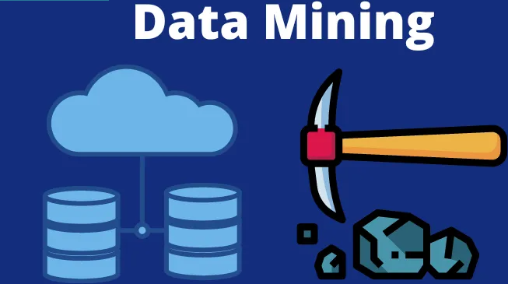
4 Data mining and Machine learning:
sklearn(scikit learn):
It is an industry-standard library of python which is mostly used for data science projects. Many machine learning algorithms and data mining problems like regression, classification, clustering, and dimensionality reduction solved with sklearn. It uses scipy internally with its many packages that allow many statistical operations for the ML model.

Slide 9
5 Statistical modeling and testing:
statsmodel:
It is another most important library of python that is used after model building to find out the statistical issues and their solutions. It is used to explore the data, estimating statistical models, and statistical testing. It allows us to perform predictive and prescriptive analytics with inferential and descriptive statistics. For example, if we have categorical data so we would use a classification model for that, but which classification model is suitable according to the business problem we will choose that model.

Slide 10




NLTK(Natural Language Toolkit
Natural language processing (NLP) is a field that focuses on making natural human language usable by computer programs. NLTK, or Natural Language Toolkit, is a Python package that you can use for NLP.
A lot of the data is unstructured data and contains human-readable text. To analyze that data programmatically, we first need to preprocess it.

Slide 11
NLTK(Natural Language Toolkit
(NLTK) is one of the largest Python libraries for performing various Natural Language Processing tasks.
From rudimentary tasks such as text pre-processing to tasks like vectorized representation of text – NLTK’s API has covered everything.

Slide 12
Punkt is a natural language processing (NLP) toolkit that specializes in Word tokenization, sentence boundary detection and tokenization. It's particularly useful for splitting text into individual sentences and words. Unsupervised learning: Punkt can be trained on raw text without requiring manually annotated training data. It is Language independence. It can hadle Abbreviation

Slide 13
Matplotlib is a powerful plotting library in Python used for creating static, animated, and interactive visualizations.
represent data graphically, making it easier to analyze and understand.
It was originally developed by John D. Hunter in 2003 and is now maintained by a large community of developers.
MATPLOTLIB
Key Features of Matplotlib:
Versatility: wide range of plots, including line plots, scatter plots, bar plots, histograms, pie charts, and more.
Customization: It offers extensive customization options to control every aspect of the plot, such as line styles, colors, markers, labels, and annotations.
Integration with NumPy: Matplotlib integrates seamlessly with NumPy, making it easy to plot data arrays directly.
Publication Quality: Matplotlib produces high-quality plots suitable for publication with fine-grained control over the plot aesthetics.
Extensible: Matplotlib is highly extensible, with a large ecosystem of add-on toolkits and extensions like Seaborn, Pandas plotting functions, and Basemap for geographical plotting.
Cross-Platform: It is platform-independent and can run on various operating systems, including Windows, macOS, and Linux.
https://www.w3schools.com/python/matplotlib_intro.asp

Slide 14


Some Applications of NLTK
Tokenization: It refers to break down the text into smaller units.
splitting paragraphs into sentences and sentences into words. It is one of the initial steps of any NLP pipeline.
Stemming and Lemmatization : In NLP we are not much interested in the form of words – rather, we are concerned with the meaning that the words intend to convey. Thus, we map every word of the language to its root/base form. This process is called canonicalization.
E.g. The words ‘play’, ‘plays’, ‘played’, and ‘playing’ convey the same action – the base form is ‘play’.
Part of Speech Tagging (POS): refers to assigning each word of a sentence to its part of speech, to give a better syntactic overview of a sentence.

Slide 15
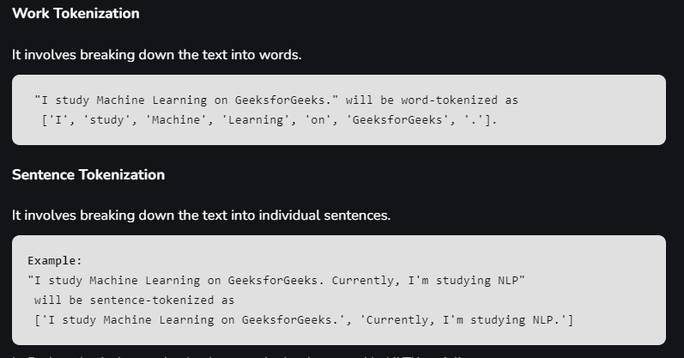

Slide 16
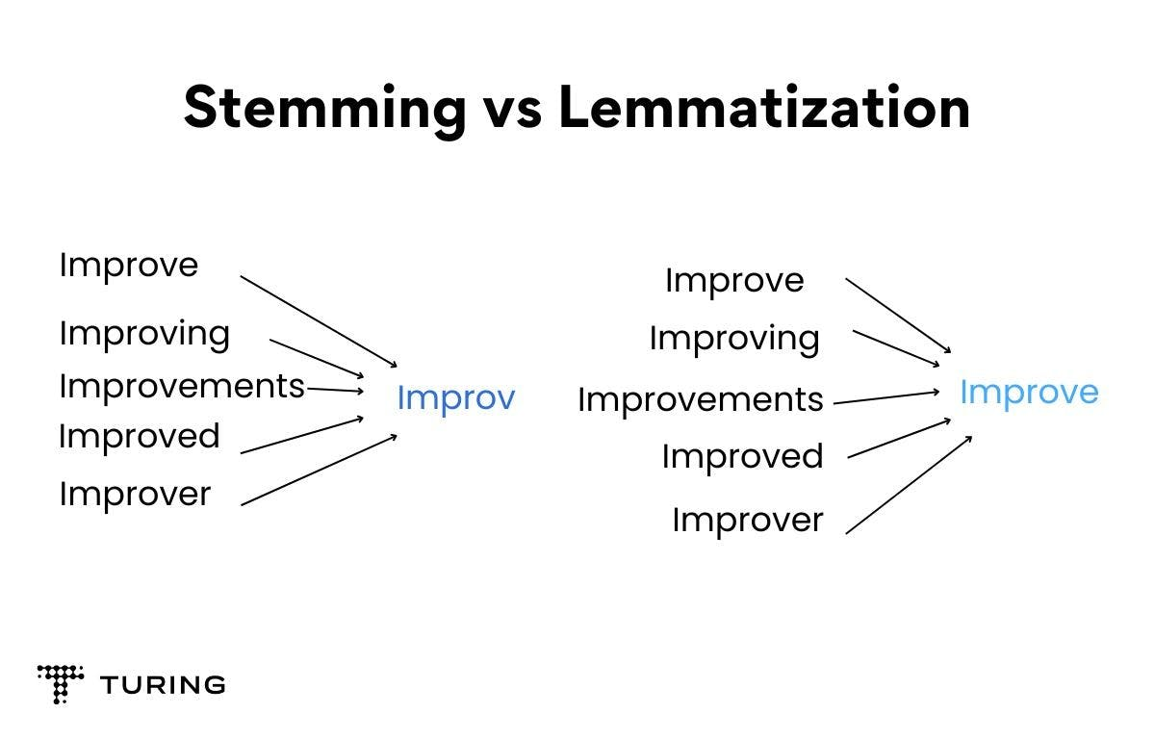
Stemming and lemmatization are both text normalization techniques used in Natural Language Processing (NLP) to reduce word inflections to a common base root word:
Stemming
A rule-based method that removes common suffixes from the end of a word, often using language-specific rules. For example, stemming the word "caring" would return "car". Stemming is faster and more straightforward than lemmatization, but it can be inaccurate and sometimes lead to incorrect meanings or spellings. Stemming is often used in large datasets where performance is an issue.
Lemmatization
A more sophisticated process that considers the context and part of speech of a word to convert it to its base or dictionary form, called a lemma. For example, lemmatizing the word "caring" would return "care". Lemmatization is more accurate than stemming, but it's computationally expensive and slower to implement
Title
The practical distinction between stemming and lemmatization is that, where stemming merely removes common suffixes from the end of word tokens, lemmatization ensures the output word is an existing normalized form of the word (for example, lemma) that can be found in the dictionary

